Slide 1

Directing and Controlling
Dr. Rajeev Kumar
1

Slide 2
Directing
Leadership Communication
Coordination Controlling
2

Slide 3
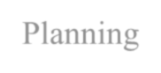

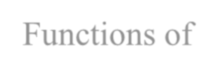


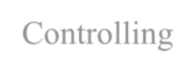

Introduction
Planning
Directing
Functions of Management
Staffing
Controlling
Organizing
3

Slide 4

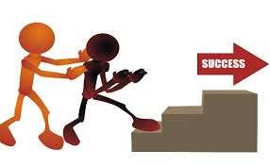
Directing
Directing is about telling people what to do and seeing that they do it to the best of their ability.
4

Slide 5





Directing as a Function of Management
Supervision
Supervision is directing efforts of employees and other resources to accomplish stated work outputs.
Supervision
Motivation
Motivation is something that moves the person to action, and continues him in the course of action already initiated / about to be initiated.
Components of Directing
Leadership
Guiding, advising and helping sub- ordinates towards accomplishment of work.
Communication
Motivation
Communication Communication is the transfer of information from one person to
another by transmitting ideas, facts, thoughts, feelings & values. In its absence, organisation would cease
Leadership
to exist.
5

Slide 6
Nature and Features of Directing
Directing involves human factor
Directing is a continuous process
Direction provides link
Directing concentrates on performance
Directing is all pervasive

Slide 7


Leadership
The activity of leading a group of people or an organization or the ability to do this.

Slide 8
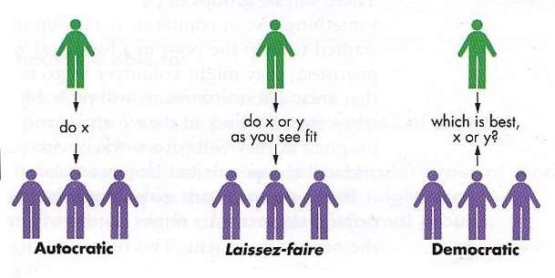
Leadership Styles
Autocratic or Authoritative Style
Democratic or Participative Style
Laissez-faire or Free-rein Style

Slide 9


Autocratic or Authoritative Style
The authoritarian leadership style keeps main emphasis on the distinction of the authoritarian leader and their followers.

Slide 10

Democratic or Participative Style
The democratic leadership style consists of the leader sharing the decision- making abilities with group members by promoting the interests of the group members and by practicing social equality..

Slide 11

Laissez-Faire or Free-Rein Style
The laissez-faire leadership style is where all the rights and power to make decisions is fully given to the worker.

Slide 12
Motivation
Performance = (Ability + Knowledge) * Motivation

Slide 13
Motivation
Motivation is the process of attempting to influence others to do your work through the possibility of gain or reward.
- Edwin B. Flippo
Motivation means a process of stimulating people to action to accomplish desired goals. - Scott
Motivation is a general term applying to the entire class of drives, desires, needs, wishes and similar forces that induces an individual or a group of people to work. – Koontz and O’Donnel

Slide 14











Characteristics of Motivation

Slide 15
Theories of Human Motivation
Maslow’s Hierarchyof Needs Theory
Herzberg’s Motivation – Hygiene Theory
McGregor’s Theory X and Theory Y
McClelland’s Three Need Model
Vroom’s Valence – Expectancy Theory
Porter and Lawler – Model of Motivation

Slide 16
Maslow’s Hierarchy of Needs Theory
Self
Actualization
Esteem Needs
Social Needs Safety Needs
Physiological Needs

Slide 17

Maslow’s Hierarchy of Needs Theory
Self
Actualization
Esteem Needs
Social Needs Safety Needs
Physiological Needs
Includes
self-advancement, self-fulfilment, self-development,
self-realization etc.,

Slide 18

Maslow’s Hierarchy of Needs Theory
Self
Actualization
Includes
self-respect, autonomy, status, recognition, responsibility, attention, achievement, prestige etc.,
Esteem Needs
Social Needs
Safety Needs
Physiological Needs

Slide 19

Maslow’s Hierarchy of Needs Theory
Self
Actualization
Esteem Needs
Social Needs Safety Needs
Physiological Needs
Includes affection, belongingness, acceptance and friendship.

Slide 20

Maslow’s Hierarchy of Needs Theory
Self
Actualization
Esteem Needs
Social Needs Safety Needs
Physiological Needs
Includes Security and protection from
physical, emotional and economical harm.

Slide 21

Maslow’s Hierarchy of Needs Theory
Self
Actualization
Esteem Needs
Includes
Food, shelter, clothing, water, sleep, love and other bodily needs.
Social Needs
Safety Needs
Physiological Needs

Slide 22






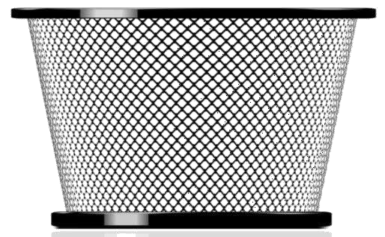
Herzberg’s Motivation – Hygiene Theory

Slide 23


Herzberg’s Motivation – Hygiene Theory
Hygiene factors
Motivators
Company policy and
administration
Supervision
Working Conditions
Salary and status
Security in job and personal life
Interpersonal relationships.
Challenging works
Responsibility
Recognition
Promotion opportunities
Achievement
Job content

Slide 24
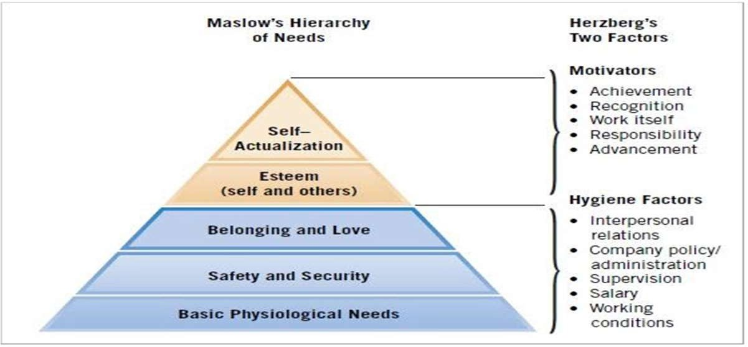
Comparison of Theories of Maslow and Herzberg

Slide 25

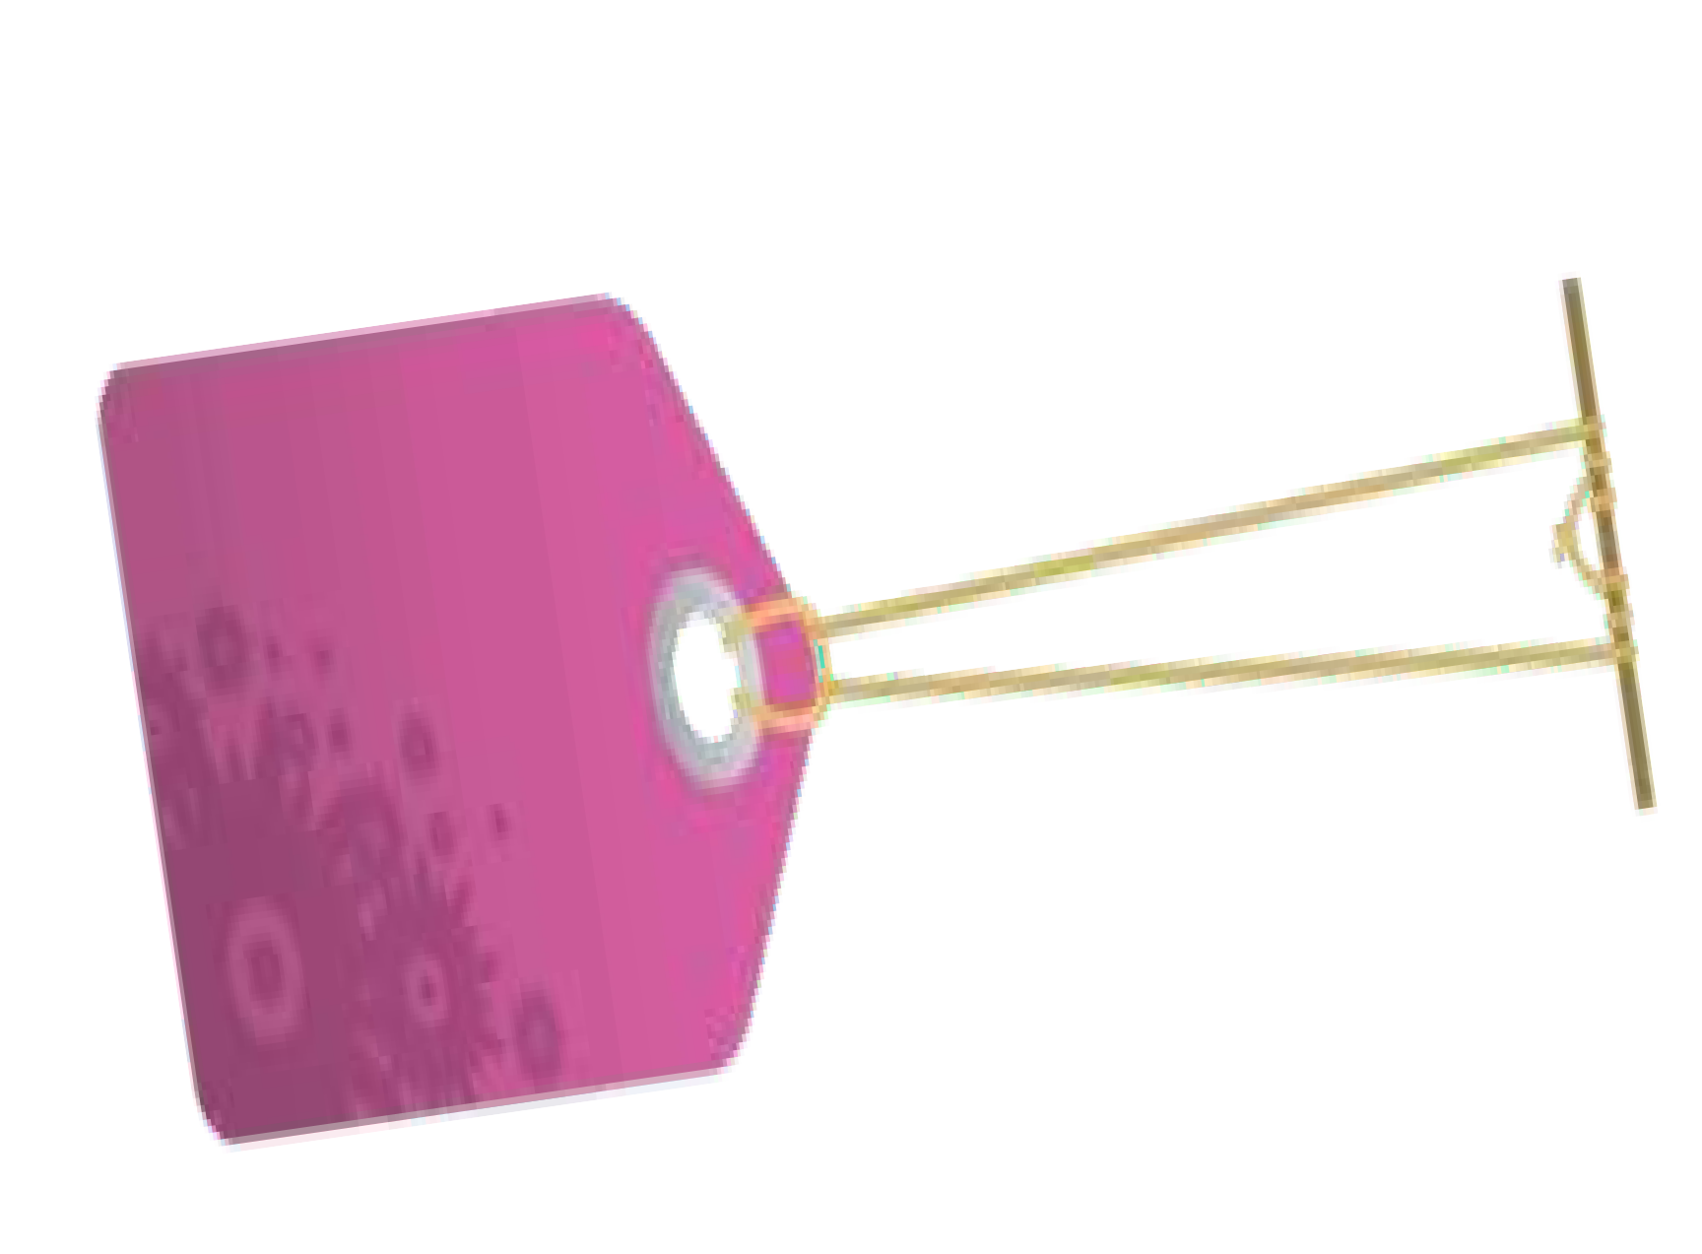




McGregor’s Theory X and Theory Y
According to Theory X,
People are lazy, dislike work and responsibilities. They are not ambitious and have to be threatened with punishment to extract work.
According to Theory Y,
People are active, like to work and take up responsibilities. They are ambitious and work voluntarily if properly motivated.

Slide 26
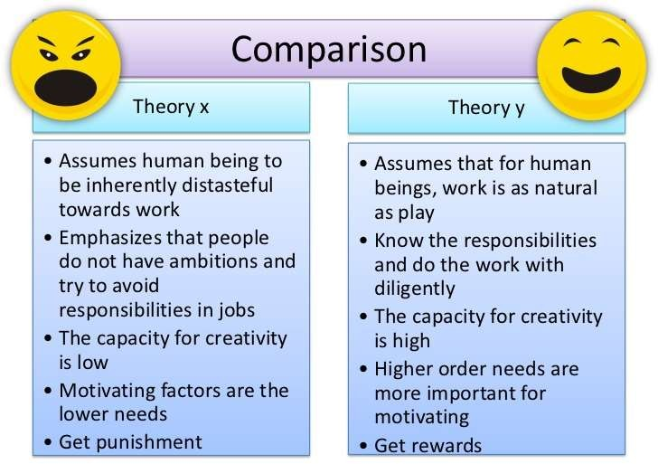
Theory X vs Theory Y

Slide 27









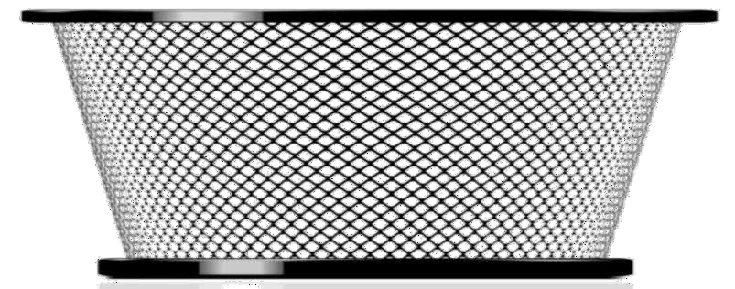
McClelland’s Three Need Model

Slide 28

Vroom’s Valence – Expectancy Theory
Force = Valence x Expectancy

Slide 29


Vroom’s Valence – Expectancy Theory
Force = Valence x Expectancy
Strength of a person’s motivation

Slide 30

Vroom’s Valence – Expectancy Theory
Force = Valence x Expectancy
Strength of an individual’s preference for an outcome

Slide 31

Vroom’s Valence – Expectancy Theory
Force = Valence x Expectancy
The probability that a particular action will lead to a desired outcome

Slide 32
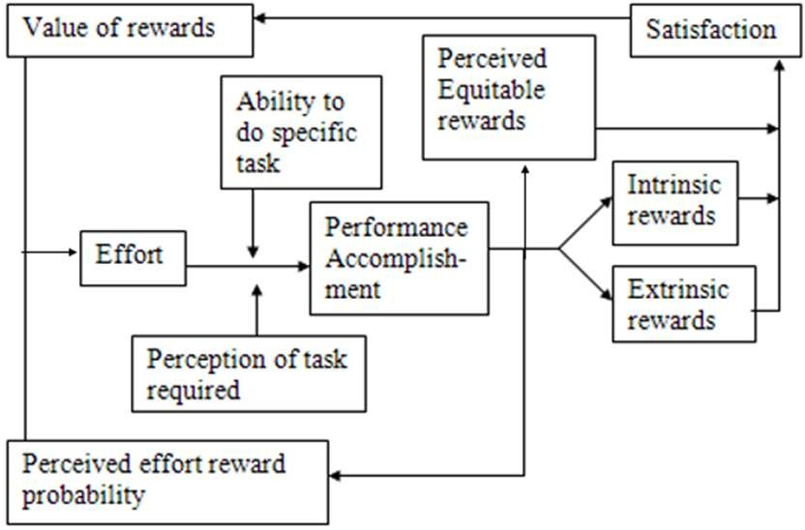
Porter and Lawler – Model of Motivation

Slide 33

Porter and Lawler – Model of Motivation
In a Complex relationship between attitudes and performance of employees,
Efforts leads to performance
Performance leads to intrinsic and extrinsic rewards Rewards leads to satisfaction
Satisfaction leads to higher efforts

Slide 34

Communication
Communication is transferring information and understanding from one to one or one to many. It could take place in a verbal or a written mode and could use forms such as face-to-face meetings, group discussions, e- mail writing, and even non verbal modes like gestures, body language, etc.

Slide 35































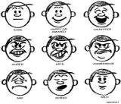






Types of Communication
Verbal
Communication
Written
Written
Non Verbal
Non Verbal

Slide 36

Importance of Communication
1
Communication is not just about speaking, its also about listening, reading, writing etc. The importance of communication can be elaborate as follows:
2
3
4
5
6
7

Slide 37


Importance of Communication
Communication accomplish work
is fundamental to
1
2
3
4
5
6
7

Slide 38
Importance of Communication
Communication facilitates planning
2
3
4
5
6
7

Slide 39
Importance of Communication
Communication improves morale and motivation
3
4
5
6
7

Slide 40
Importance of Communication
Communication is the basis of co-ordination
4
5
6
7

Slide 41
Importance of Communication
Communication is key to managerial efficiency
5
6
7

Slide 42
Importance of Communication
Communication helps in decision making
6
7

Slide 43
Importance of Communication
Communication improves relationships
7

Slide 44

Co-ordination
Co-ordination refers to the orderly arrangement of individual and group efforts to ensure unity of action in the realization of common goals. – Mooney and Reiley
Co-ordination means, to unite and correlate all activities.
– Henry Fayol

Slide 45
Features of Co-ordination
Co-ordination implies deliberate actions on the part of managers to bring about harmony and unity of actions.
Co-ordination applies to group efforts, and not to individual effort. It involves the orderly arrangement of group efforts.
Co-ordination does not result in a one-shot action. It is continuous action.
Co-ordination is all pervasive.
Co-ordination is necessary not only within organization but also of the organization with the outside environment.

Slide 46
Importance of Co-ordination
Co-ordination increases efficiency
1
2
3
4
5
6

Slide 47
Importance of Co-ordination
Co-ordination makes all departments focus together
2
3
4
5
6

Slide 48
Importance of Co-ordination
Co-ordination helps sharing of resources
3
4
5
6

Slide 49
Importance of Co-ordination
Co-ordination improves human relations
4
5
6

Slide 50
Importance of Co-ordination
5
Co-ordination resolves conflicts
6

Slide 51
Importance of Co-ordination
Co-ordination retains and attracts talent
6

Slide 52
Techniques of Co-ordination
Co-ordination by plans and procedures
Co-ordination by sound and simple organization
Co-ordination by chain of command
Co-ordination by effective communication
Co-ordination by committees
Co-ordination by conference
Co-ordination by special co-ordinators
Co-ordination through sound leadership

Slide 53
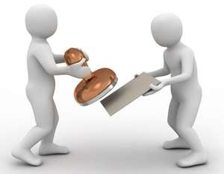
Controlling
Control consists in verifying whether everything occurs in conformity with the plans, instructions and principles established. – Henry Fayol
Control is checking current performance against pre- determined standards contained in the plans, in order to ensure adequate progress and satisfactory performance.
– E F L Brech

Slide 54
Features of Controlling
Controlling is a positive force.
Controlling is a dynamic and continuous process.
Controlling is goal-oriented.
Controlling is forward looking.
Control process is universal.
Control is based on planning.
Delegation is key to control.

Slide 55
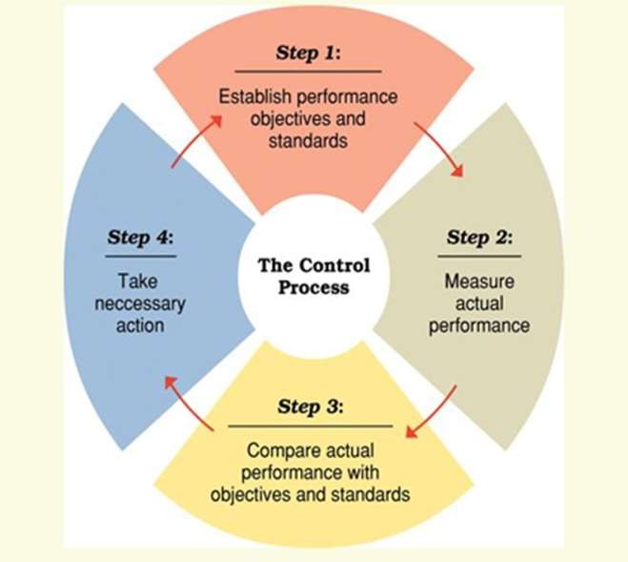
Steps in Controlling

Slide 56

Steps in Controlling
Step 1: Setting of standards
Standards are the targets against which actual performance will be compared.
Standards are the criteria of performance, they serve as benchmarks as they specify acceptable levels of performance.

Slide 57

Steps in Controlling Cont..
Step 1: Setting of standards
Control standards are broadly divided into two types:
Quantitative Standards
Qualitative Standards
Standards which can be quantified. Example: Production level, rejection level, profit, labor-hours, speed of service, sales volume, expenses etc.
Standards which are qualitative. Example: Employee morale, brand image, company image, goodwill, industrial relations etc.

Slide 58


Steps in Controlling Cont..
Step 2: Measurement of performance
Aspects of measurement
The actual performance measurement has to be complete in all respects.
All aspects of the job has to be measured and not just the ones that are more evident.
Completion
Objective
Performance at work should be measured in an objective manner without fear, favour and bias.
The management
of any performance should
Responsiveness
support the belief that effort and performance lead
to improvement, both from the personal and
organizational point of view.

Slide 59

Steps in Controlling Cont..
Step 3: Comparison of actual performance with standards
The third step in control process is to compare the actual performances with established standards and ascertaining the causes of deviation.
Deviations are thoroughly analyzed and properly presented.
Statistical methods are usually adopted to look at deviation from a border perspective.

Slide 60

Steps in Controlling Cont..
Step 4: Taking corrective measures
The final step in control process consists of taking remedial actions so that deviation may not occur again in future.
Corrective steps are initiated so that any defects in the actual performance may be rectified.

Slide 61

Steps in Controlling Cont..
Step 4: Taking corrective measures
Corrective actions may include the following activities:
Change in methods, rules, procedures, strategies etc.
Introduce training programs.
Job redesign or Replacement of personnel.
Re-establishing budgets and standards.
Better compensation packages to employees.
Changing machinery and processes.
Identifying recurring bottle necks and avoiding them.

Slide 62
The Control Process
Step I
Step II
Step III
Step IV
Setting of standards
Measuring of actual performance
Comparison of actual performance with standards
Taking corrective measures
Feedback

Slide 63
Essentials of a Sound Control Process
Clear definition of objectives and standards
Selecting efficient control techniques
Suitability of control system
Simplicity
Focus on key area

Slide 64
Essentials of a Sound Control Process Cont..
Flexibility
Reasonable and practical
Economical
Self-Control
Acceptable to all

Slide 65
Essentials of a Sound Control Process Cont..
CleCalreadrefdienfiitnioitnioonf oofbojebcjteicvteisveasnd ansdtasntdanarddasrds
Selecting efficient control techniques
Suitability of control system
Simplicity Focus on key area
Before planning a control system, objectives have be clearly defined along with establishment of realistic standards.

Slide 66
Essentials of a Sound Control Process Cont..
Clear definition of objectives and standards
Selecting efficient control
techniques
Suitability of control system
Simplicity Focus on key area
Control techniques have to detect deviations from standards and make possible corrective action at an early stage with minimum damage.
Selecting efficient control
techniques

Slide 67
Essentials of a Sound Control Process Cont..
Clear definition of objectives and standards
Selecting efficient control techniques
Suitability of control system
Simplicity Focus on key area
Control system should be
suitable to the needs of
any given department. For Example,
Suitability of control system
control
by may
system used production dept.
vary from marketing dept.
that of

Slide 68
Essentials of a Sound Control Process Cont..
Clear definition of objectives and standards
Selecting efficient control techniques
Control process should be
Suitability of control system
easy to understand and
the
implement employees
so that
can interpret
Simplicity
Simplicity
the same in right way and
ensure implementation.
Focus on key area

Slide 69
Essentials of a Sound Control Process Cont..
Clear definition of objectives and standards
Selecting efficient control techniques
Suitability of control system
Control system should
focus on key areas which
Simplicity
are critical performance profitability.
to and
Focus on key area
Focus on key area

Slide 70
Essentials of a Sound Control Process Cont..
Control system must be responsive and flexible to new developments including the failure of original control process itself.
Flexibility
Reasonable and practical
Economical
Self-Control
Acceptable to all

Slide 71
Essentials of a Sound Control Process Cont..
Flexibility
Control system must be reasonable, practical, justifiable and attainable. If expectations are too high and un-achievable, they de-motivate employee, and the control process becomes meaningless.
Reasonable and practical
Reasonable and practical
Economical
Self-Control
Acceptable to all

Slide 72
Essentials of a Sound Control Process Cont..
Flexibility
Reasonable and practical
Control system should be
Economical
economical and easy to maintain. It should justify the expenses involved.
Economical
Self-Control
Acceptable to all

Slide 73
Essentials of a Sound Control Process Cont..
Flexibility
Reasonable and practical
If each department or team has its own control system, it becomes much easier. These sub-system of self-control can be tied together by the overall control system.
Economical
Self-Control
Self-Control
Acceptable to all

Slide 74
Essentials of a Sound Control Process Cont..
Flexibility
Reasonable and practical
Controls become more
acceptable when they are:
Objective, i.e., based on factual and verifiable info.
Quantifiable
Understood by one and all
Economical
Self-Control
Acceptable to all
Acceptable to all

Slide 75





Methods of Establishing Control

Slide 76

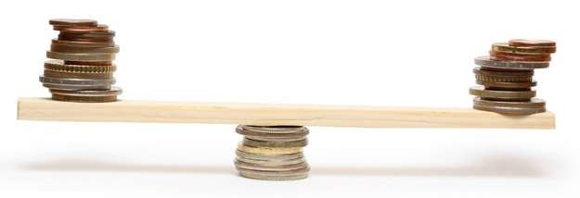
Traditional Control Techniques
1. Budgetary control
2. Standard costing

Slide 77
Budgetary Control
Budgets are nothing but written plans or programs of the future activities expressed in monetary terms.
Budgetary control is used to control the costs through continuous appraisals of actual expenditures as against planned costs expressed in a budget.

Slide 78
Budgetary Control Cont..
Advantages Limitations
Revision required
Uncertain future
Maximization of profit
Tool for measuring performance
Reduced costs
Determine weaknesses
Corrective action
Depends support
upon the
of top
management
Conflicts among the
departments

Slide 79
Standard Costing
Standard costing is a method of estimating the right cost or the most efficient cost of manufacturing a product.
Standard costing is an important activity to determine the efficiency of cost controlling in an industry.

Slide 80
Modern Control Techniques
Break-even analysis.
PERT - Program Evaluation Review Technique
CPM - Critical Path Method
SQC - Statistical Quality Control
Internal audit
MIS - Management Information System
Quality circles

Slide 81
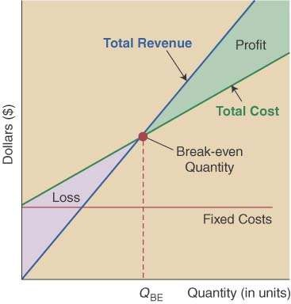
Break-Even Analysis
Break even analysis involves understanding the costs involved in producing a product and thereby fix the selling price in order to make a particular profit.

Slide 82
Break-Even Analysis Cont..
Break even analysis is used:
To find the effect of varying selling price upon profit.
To find the effect of fixed costs and variable cost upon profit.
To find the minimum production required to break-even i.e., no loss-no profit.
To compare two or more products with respect to their profitability and cost of production.
To find what quantity of production leads to what costs.

Slide 83
PERT – Program Evaluation Review Technique
In PERT activities are precedence relationships
shown as a network of using activity-on-arrow
network construction
Multiple time estimates
Probabilistic activity times
Used in: Project management - for non-repetitive jobs (research and development work), where the time and cost estimates tend to be quite uncertain. This technique uses probabilistic time estimates.

Slide 84
CPM – Critical Path Method
In CPM activities are precedence relationships
shown as a network of using activity-on-node
network construction
Single estimate of activity time
Deterministic activity times
Used in : Production management - for the jobs of repetitive in nature where the activity time estimates can be predicted with considerable certainty due to the existence of past experience.
84

Slide 85
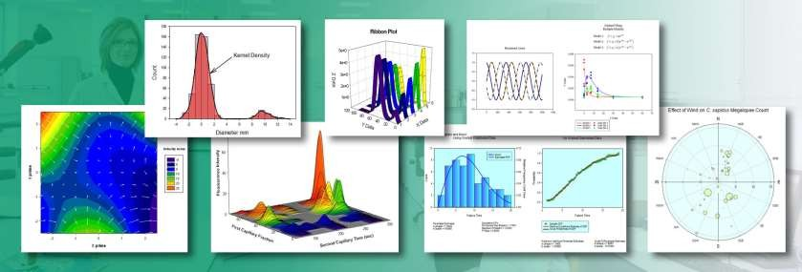
SQC – Statistical Quality Control
SQC involves the application of statistical techniques to study deviation in actual performance against established standards. The results are analyzed and interpreted in order to help take corrective measures.
85

Slide 86
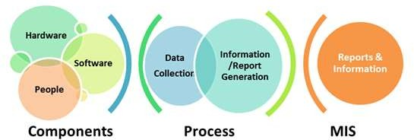
MIS – Management Information System
MIS is a computer based system that provides information and support for effective managerial decision making.
86

Slide 87
Internal Audit
An audit is a systematic and impartial examination, analysis and appraisal of management’s overall performance.
It is an independent and critical evaluation of the entire management process.
An audit may be undertaken by the management itself
or it may be carried out with the help of management consultants.
87

Slide 88
Quality Circles
A quality circle is a small group of employees who meet periodically to identify, analyze and solve quality and other work related problems in their area of operation.
88

Slide 89
Other Control Techniques
Policies and procedures
Standing rules, limitation and orders
Self-control
Group control
Personal observations or MBWA
Disciplinary action
89

Slide 90
Policies
Policies are guidelines set up by the company for managerial decision making.
‘A policy is a verbal, written or implied overall guide setting up boundaries that supply the general limits and directions in which managerial actions will take place’.
For Example,
Policy of recruiting only MBA’s from top 10 institutes.
Policy of promotion of in-house employees.
Policy on selling goods only for cash and not credit.
90

Slide 91
Procedures
Procedures are action guidelines which specify how particular activity has to take place.
Procedures provide chronological step-by-step sequence of required actions in order to achieve a certain goal or policy.
A procedure lays down the manner and method by which work is to be performed in a standard or uniform way.
91

Slide 92

Standing Rules, Limitation and Orders
These act as important control devices. When sub -ordinates
are given freedom to make certain decisions on behalf of
superiors, it beomes necessary to lay down limits for them.
Standing orders are those which apply to every one in the
organization and which are helpful in having discipline.
For Example: No smoking, No walking on the lawn etc.
92

Slide 93
Self Control
Self-Control means self-directed control. A person is given
freedom to set his own targets, evaluate his own performance and take corrective measures as and when required. Self-control is especially required for top level managers because they do not like external control.
93

Slide 94

Group Control
Group control can be achieved through effective and inspirational leadership.
94

Slide 95
Personal Observations or MBWA
MBWA refers to a controlling techniques in which a
manager spends a significant amount of his time regularly in the work area, and interacts directly with employees.
Managing by walking around requires, personal involvement, good listening skills, and the recognition that most people in an organization want to contribute to its success.
95

Slide 96
Disciplinary Action
Disciplinary action is a negative approach to
controlling function but nevertheless necessary.
Disciplinary action becomes effective when the employees controlled are unskilled, rustic, brash, and unweilding.
96

Slide 97
PERT and CPM Network Scheduling Problem
Basic Network Definitions,
Activity: Any portions of project (tasks) which required by project, uses up resource and consumes time – may involve labor, paper work, contractual negotiations, machinery operations
Event : Beginning or ending points of one or more activities, instantaneous point in time, also called ‘nodes’
Network: Combination of all project activities and the events
Proceeding
Activity
Successor
Event
97

Slide 98
Scheduling Activity: Problem 1
Consider the scheduling activity,
Activity | Immediate Predecessors | Completion Time (Week)
A | - | 5
B | - | 6
C | A | 4
D | A | 3
E | A | 1
F | E | 4
G | D,F | 14
H | B,C | 12
I | G,H | 2
98

Slide 99
Calculation of ES and EF Time (Problem 1)
Starting at the network’s origin (node 1) and using a starting time of 0, we compute an earliest start (ES) and earliest finish (EF) time for each activity in the network.
The expression EF = ES + t can be used to find the earliest finish time for a given activity.
For example, for activity A, ES = 0 and t = 5; thus the earliest finish time for activity A is, EF = 0 + 5 = 5
99

Slide 100
Arc with ES and EF Time (Problem 1)
ES = earliest start time
EF = earliest finish time
Activity
2
1
t = expected activity time
100

Slide 101




Network with ES and EF time (Problem 1)
D[5,8]
3
5
2
7
4
1
6
3
Earliest start time rule: The earliest start time for an activity leaving a particular node is equal to the largest of the earliest finish times for all activities entering the node.
101

Slide 102
Calculation of LS and LF (Problem 1)
To find the critical path we need a backward pass
calculation.
Starting at the completion point (node 7) and using a latest finish time (LF) of 26 for activity I, we trace back through the network computing a latest start (LS) and latest finish time for each activity
The expression LS = LF – t can be used to calculate latest start time for each activity. For example, for activity I, LF = 26 and t = 2, thus the latest start time for activity I is LS = 26
– 2 = 24.
102

Slide 103
Activity, Duration, ES, EF, LS and LF (Problem 1)
ES = earliest start time
EF = earliest finish time
Activity
3
2
LF = latest finish time
t = expected activity time
LS = latest start time
103

Slide 104
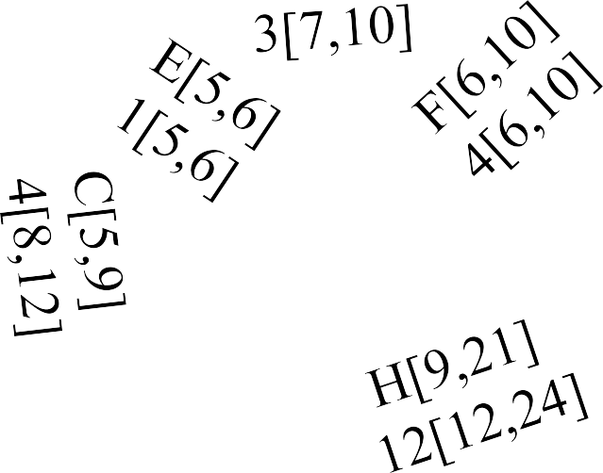

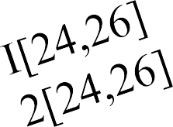
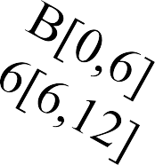
Network with ES, EF, LS and LF Time (Problem 1)
5
2
7
4
1
6
3
Latest finish time rule:
The latest finish time for an activity entering a particular node is equal to the smallest of the latest start times for all activities leaving the node.
104

Slide 105




Network with Critical Path (Problem 1)
5
2
7
4
1
6
3
105

Slide 106
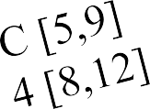
Slack or Free Time or Float (Problem 1)
Slack is the length of time an activity can be delayed without affecting the completion date for the entire project.
For example, slack for C = 3 weeks, i.e. Activity C can be delayed up to 3 weeks
(start anywhere between weeks 5 and 8).
3
2
ES
LS EF
LF
5
8 9
12
LF-EF = 12 –9 =3
LS-ES = 8 – 5 = 3
LF-ES-t = 12-5-4 = 3
106

Slide 107
Activity Schedule (Problem 1)
Activity | Earliest Start (ES) | Latest Start (LS) | Earliest Finish (EF) | Latest Finish (LF) | Slack (LS-ES) | Critical Path
A | 0 | 0 | 5 | 5 | 0 | Yes
B | 0 | 6 | 6 | 12 | 6 | -
C | 5 | 8 | 9 | 12 | 3 | -
D | 5 | 7 | 8 | 10 | 2 | -
E | 5 | 5 | 6 | 6 | 0 | Yes
F | 6 | 6 | 10 | 10 | 0 | Yes
G | 10 | 10 | 24 | 24 | 0 | Yes
H | 9 | 12 | 21 | 24 | 3 | -
I | 24 | 24 | 26 | 26 | 0 | Yes
107

Slide 108
Scheduling Activity: Problem 2
Consider the scheduling activity,
Number | Activity | Predecessor | Duration
1 | Design house and obtain financing | -- | 3 months
2 | Lay foundation | 1 | 2 months
3 | Order and receive materials | 1 | 1 month
4 | Build house | 2,3 | 3 months
5 | Select paint | 2, 3 | 1 month
6 | Select carpet | 5 | 1 month
7 | Finish work | 4, 6 | 1 month
108

Slide 109
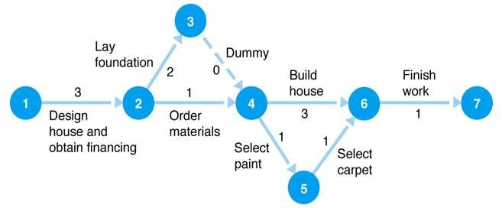
Scheduling Activity (Problem 2)
Consider the scheduling activity,
109

Slide 110
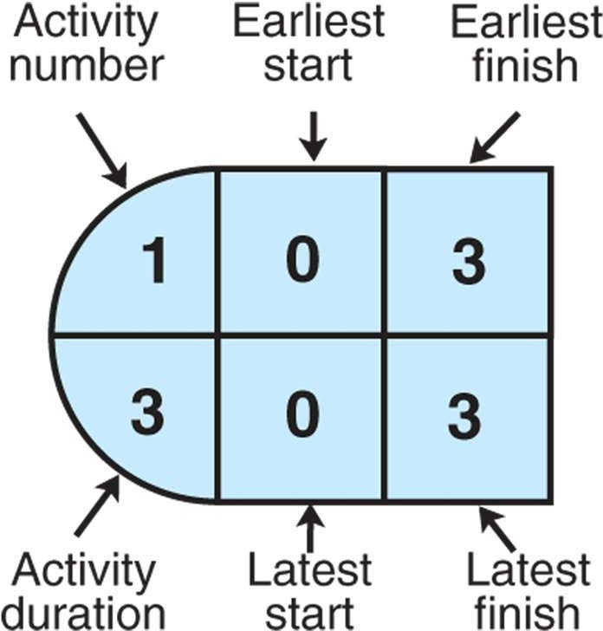
Activity-on-Node Configuration (Problem 2)
110

Slide 111
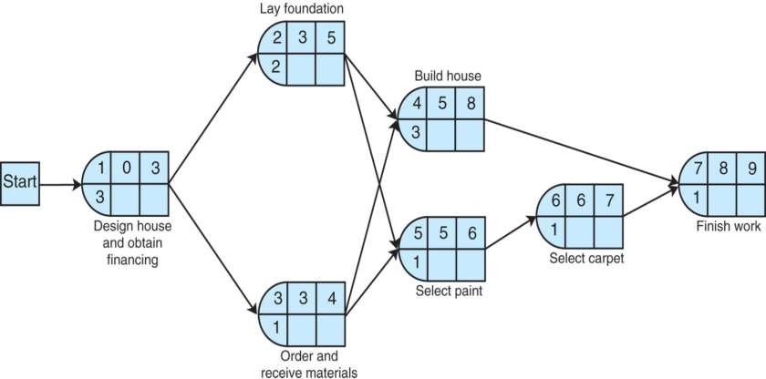
Network with ES and EF Time (Problem 2)
Initially for start node ES = 0 and then ES is calculated as follows,
ES = Maximum EF {immediate predecessor} EF = ES + t
111

Slide 112
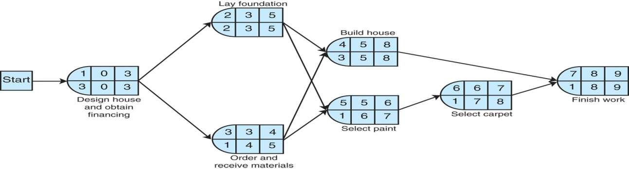
Network with ES, EF, LS and LF Time (Problem 1)
LF and LS is computed in backward pass, initially for last node LF is equal to its EF, for rest of the nodes LF and LS are computed as follows,
LS = LF – t and LF = Minimum LS {following activity}
112

Slide 113
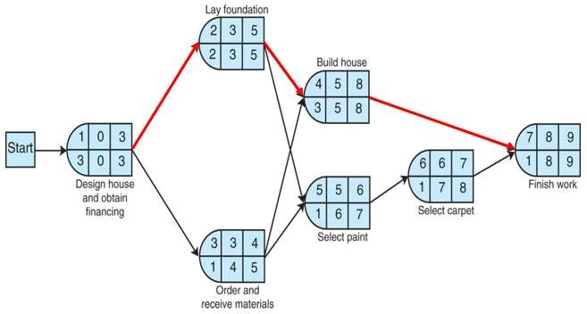
Network with Critical Path (Problem 2)
113

Slide 114
Activity Schedule (Problem 2)
Activity | Latest Start (ES) | Earliest Start (LS) | Latest Finish (EF) | Earliest Finish (LF) | Slack (LS-ES) | Critical Path
1 | 0 | 0 | 3 | 3 | 0 | Yes
2 | 3 | 3 | 5 | 5 | 0 | Yes
3 | 4 | 3 | 5 | 4 | 1 | -
4 | 5 | 5 | 8 | 8 | 0 | Yes
5 | 6 | 5 | 7 | 6 | 1 | -
6 | 7 | 6 | 8 | 7 | 1 | -
7 | 8 | 8 | 9 | 9 | 0 | Yes
114

Slide 115
Thank You
115

